Slide 1

RANDOM FOREST: INTUITION
Random Forest Classifier is a type of ensemble algorithm.
It creates a set of decision trees from randomly selected subset of training set.
It then combines votes from different decision trees to decide the final class of the test object.
TREE #1
TREE #2
TREE #N
Savings>$1M
Savings>$1M
Savings>$1M
Yes
No
Yes
No
Yes
No
Age > 45?
Class #0
Age > 45?
Class #0
Age > 45?
Class #0
Yes
No
Yes
No
Yes
No
Class #1
Class #0
Class #1
Class #0
Class #1
Class #0
OUT = CLASS #1
OUT = CLASS #1
OUT = CLASS #0
MAJORITY VOTE = CLASS #1

Slide 2
RANDOM FOREST: WHY AND HOW?
It overcomes the issues with single decision trees by reducing the effect of noise.
Overcomes overfitting problem by taking average of all the predictions, canceling out biases.
Suppose training set: [X1, X2, X3, X4] with labels: [L1, L2, L3, L4]
Random forest creates three decision trees taking inputs as follows:
[X1, X2, X3], [X1, X2, X4], [X2, X3, X4]
Example: Combining votes from a pool of experts, each will bring their own experience and background to solve the problem resulting in a better outcome.
Complete Training set
Training
set #1
Training
set #2
Training
set #3
Decision Tree #1
Decision Tree #2
Decision Tree #3
VOTING

Slide 3

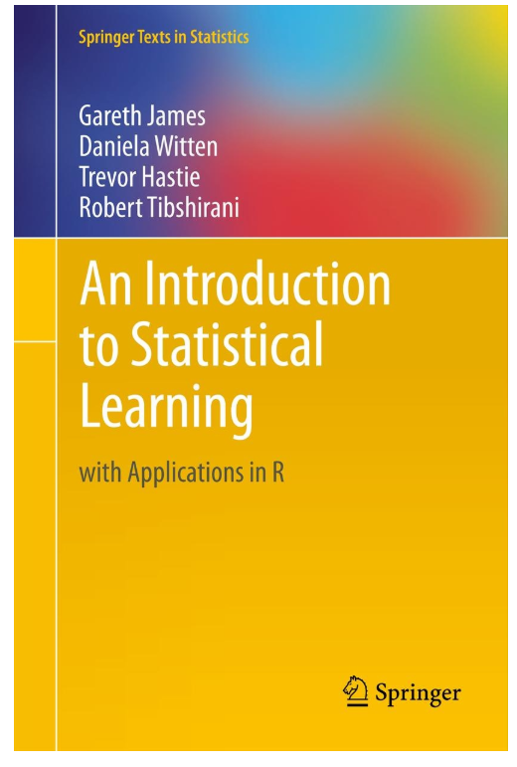
RANDOM FOREST: ADDITIONAL READING MATERIAL
Additional Resources, Page #255: http://www.cs.huji.ac.il/~shais/UnderstandingMachineLearning/understanding-machine-learning-theory-algorithms.pdf
Additional Resources, Page #320:
http://www-bcf.usc.edu/~gareth/ISL/ISLR%20Seventh%20Printing.pdf

